Slide 1
Registers & Flags
Subject: CE-420 Computer Organization & Architecture

Slide 2
Registers
Registers are high-speed storage locations inside the CPU, designed to be accessed at much higher speed than conventional memory.
Types of registers
  General Purpose/Data Registers
    Hold data for an operation to be performed
    There are 4 data registers (AX, BX, CX, DX)
  Segment Registers
    Hold the address of an instruction or data element
    Segment registers (CS, DS, ES, SS)
  Index and Pointer Registers
    Pointer registers (SP, BP, IP)
    Index registers (SI, DI)
  Status/Flags Register (FLAGS)
    Keeps the current status of CPU or results of arithmetic operations

Slide 3
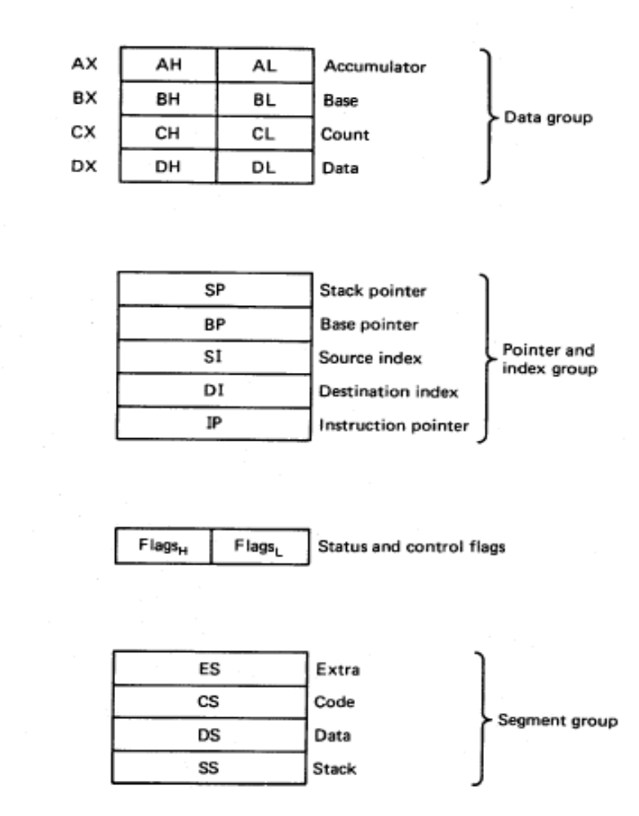
8086 Internal registers 16 bits (2 bytes each)
AX, BX, CX and DX are two
bytes wide and each byte can
be accessed separately
These registers are used as
memory pointers.
6 status; 3 control ; 7 unused
Segment registers are used
as base address for a segment

Slide 4
General Purpose Registers
AX (Accumulator): Used by CPU for arithmetic operations.
BX (Base): It can hold a memory address that points to a variable.
CX (Counter): Act as a counter for repeating or looping instructions. These instructions automatically repeat and decrement CX and quit when equals to 0.
DX (Data): It has a special role in multiply and divide operations.

Slide 5
Segment Registers
Generate memory addresses along with other registers
CS, DS, ES, SS
CS (Code): Defines the starting address of the section of memory holding code.
DS (Data): Defines the section of memory that holds most of the data used by programs.
ES (Extra): This is an additional data segment that is used by some of the string instructions.
SS (Stack): It defines the area of the memory used for stack

Slide 6
Pointers and Index Registers
IP, BP, SP, SI, DI
These can be accessed only as 16 bit registers.
IP - instruction pointer: Always points to next instruction to be executed. IP register always works together with CS segment register and it points to currently executing instruction.
SI - source index register: Can be used for pointer addressing of data. Offset address relative to DS
DI - destination index register: Can be used for pointer addressing of data . Offset address relative to ES
SI and DI used in string movement instructions.
SP and BP are used to access data inside the stack segment
BP - base pointer: Primarily used to access parameters passed via the stack. Offset address relative to SS
  SP – stack pointer: Always points to top item on the stack. Offset address relative to SS

Slide 7
80386 Extended Registers
The 80386/80486 processor contain 32-bit registers which greatly improve the efficiency of program that take advantage of them.
  EAX, EBX, ECX, EDX,
  EFLAGS
  EIP
  EBP, ESP, ESI, EDI.

Slide 8
Flag Register
16-bit special register
Each bit position is assigned to show the status of CPU or the results of arithmetic operations.
Each relevant bit position is given a name; other positions are undefined.
Two Types:
  Control Flags: Individual bits may be set to control the CPU’s Operation
  Status Flags: The Status bits reflect the outcome of arithmetic and logical operations performed by the CPU.

Slide 9
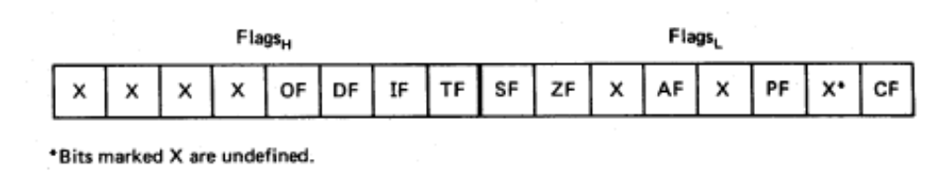
Flags
Carry flag
Overflow
Direction
Parity flag
Interrupt enable
Auxiliary flag
Trap
Zero
6 are status flags
3 are control flag
Sign

Slide 10
Status Flags
Carry Flag: The Carry Flag is set to 1 if after the result of an ALU operation, there is a carry out from the MSB else it is 0
Sign Flag: The Sign Flag is set to the value of the MSB. If the MSB is 0 then the Sign flag is 0, if the MSB is 1 then the Sign Flag is 1.
Zero Flag: If after an ALU operation the result of the operation is All Zeros, then the Zero Flag is set to 1 otherwise it is set to 0.
Overflow Flag: It is set when the signed result of an arithmetic operation is too large to fit into destination area.
Auxiliary Carry Flag: is set when an operation causes a carry from bit 3 to bit 4 or borrow from bit 4 to bit 3.
Parity Flag: reflects the number of bits in the result of an operation that are set. If number is even, parity is even. If it is odd, parity is odd. This is used by Operating System to verify correct transmission of data.

Slide 11
Control Flags
Direction Flag: Controls the assumed direction used by string processing instructions. 1=Up, 0=Down
Interrupt Flag: Enable/Disable external interrupt.
Trap Flag: determines whether or not CPU will be halted after each instruction.

Slide 12
Default Values
When Debug is first loaded, the following defaults are in the effect:
  All segment registers are set to the bottom of free memory, just above debug program.
  IP is set to 0100h.
  Debug reserves 256 bytes of stack space at the end of current segment.
  All of available memory is allocated (reserved).
  The flags are set to the following values: NV (Overflow flag clear), UP (Direction flag= up), EI (interrupt enabled), PL (Sign flag = positive), NZ (Zero flag set), NA (Auxiliary Carry Flag clear), PO (Odd Parity), NC (Carry flag clear)

Slide 13
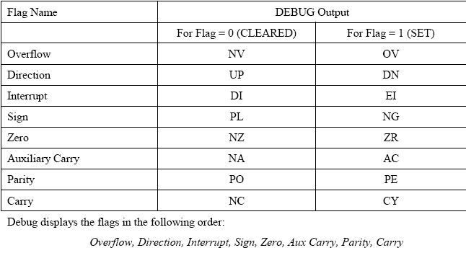

Slide 14
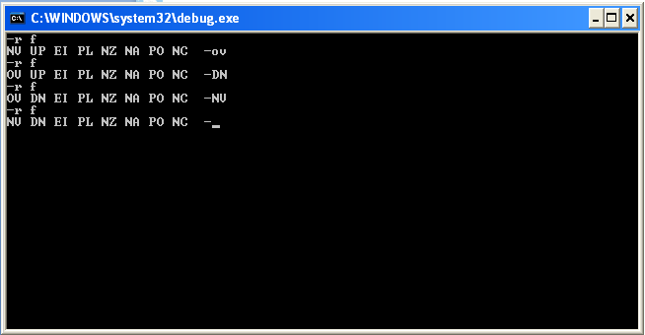
How to Change Flag Bits

Slide 15
Flag Examples
What is the state of flags after the following addition.
10001011
10101000
00110011
There is a carry out of the MSB so CF=1
The MSB of the Result is 0 so the SF=0
The Result is not all zeros so ZF=0

Slide 16
Arithmetic Instructions
INC and DEC Instructions
  Inc al ; increment 8-bit register
  Dec bx ;decrement 16-bit register
ADD Instruction
  Add destination, source
  Add al, 1
  Add al, cl
SUB Instruction
  Sub destination, source
  Sub al,1
  Sub cl, al
Flags Affected by ADD and SUB: Zero Flag, Sign flag, Carry Flag, Overflow Flag

